Slide 1


Introduction to JVM Memory
…and GC
@danlucianrosu

Slide 2
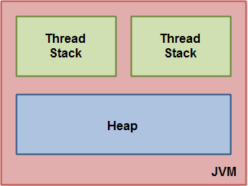


The Java virtual machine is a model of a whole computer so this model naturally includes a memory model - AKA the Java Memory Model.
Internally, the JVM divides memory between thread stacks and the heap
(For internal use only) @danlucianrosu
Notes:
Each JVM implementation for a specific operating system, translates the Java programming instructions into instructions and commands that run on the local operating system. This way, Java programs achieve platform independence.
The HotSpot JVM possesses an architecture that supports a strong foundation of features and capabilities and supports the ability to realize high performance and massive scalability. For example, the HotSpot JVM JIT compilers generate dynamic optimizations. In other words, they make optimization decisions while the Java application is running and generate high-performing native machine instructions targeted for the underlying system architecture.

Slide 3
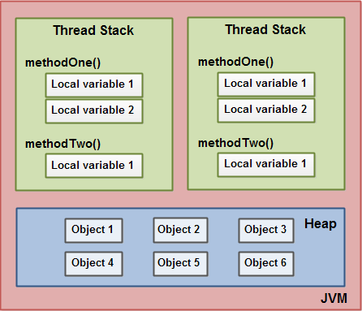
Each thread running in the Java virtual machine has its own thread stack.
The thread stack contains information about what methods the thread has called to reach the current point of execution. This is referred as the "call stack". As the thread executes its code, the call stack changes.
(For internal use only) @danlucianrosu
Notes:
The thread stack also contains all local variables for each method being executed (all methods on the call stack). A thread can only access it's own thread stack. Local variables created by a thread are invisible to all other threads than the thread who created it.
All local variables of primitive types ( boolean, byte, short, char, int, long, float, double) are fully stored on the thread stack and are thus not visible to other threads.

Slide 4

What
about heap?

Slide 5
Short note
The heap contains all objects created in your Java application, regardless of what thread created the object. This includes the object versions of the primitive types (e.g. Byte, Integer, Long etc.). It does not matter if an object was created and assigned to a local variable, or created as a member variable of another object, the object is still stored on the heap.
(For internal use only) @danlucianrosu

Slide 6
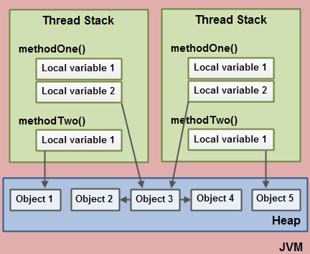
Aha! But variables that hold references where are stored?
Let’s make it clear
A local variable may be of a primitive type, in which case it is totally kept on the thread stack.
A local variable may also be a reference to an object. In that case the reference (the local variable) is stored on the thread stack, but the object itself if stored on the heap.
3. An object may contain methods and these methods may contain local variables. These local variables are also stored on the thread stack, even if the object the method belongs to is stored on the heap.

Slide 7
And...
An object's member variables are stored on the heap along with the object itself. That is true both when the member variable is of a primitive type, and if it is a reference to an object.
Static class variables are also stored on the heap along with the class definition.
(For internal use only) @danlucianrosu
Notes:
Metaspace - Metaspace stores the Class definitions of your Objects. The size of Metaspace is controlled by setting -XX:MetaspaceSize.
In JDK 8, classes metadata is now stored in the native heap and this space is called Metaspace.
Additional JVM overhead - In addition to the above values there is some memory consumed by the JVM itself. This holds the C libraries for the JVM and some C memory allocation overhead that it takes to run the rest of the memory pools above.

Slide 8
Profiling memory use
It is important to understand how an application will use memory in both a development and production environment. The majority of memory issues can be reproduced in any environment without significant effort.
(For internal use only) @danlucianrosu

Slide 9


Slide 10

In a programming language like C, allocating and deallocating memory is a manual process. In Java, process of deallocating memory is handled automatically by the garbage collector.

Slide 11
What is Automatic Garbage Collection?
Automatic garbage collection is the process of looking at heap memory, identifying which objects are in use and which are not, and deleting the unused objects. An in use object, or a referenced object, means that some part of your program still maintains a pointer to that object. An unused object, or unreferenced object, is no longer referenced by any part of your program. So the memory used by an unreferenced object can be reclaimed.
(For internal use only) @danlucianrosu

Slide 12
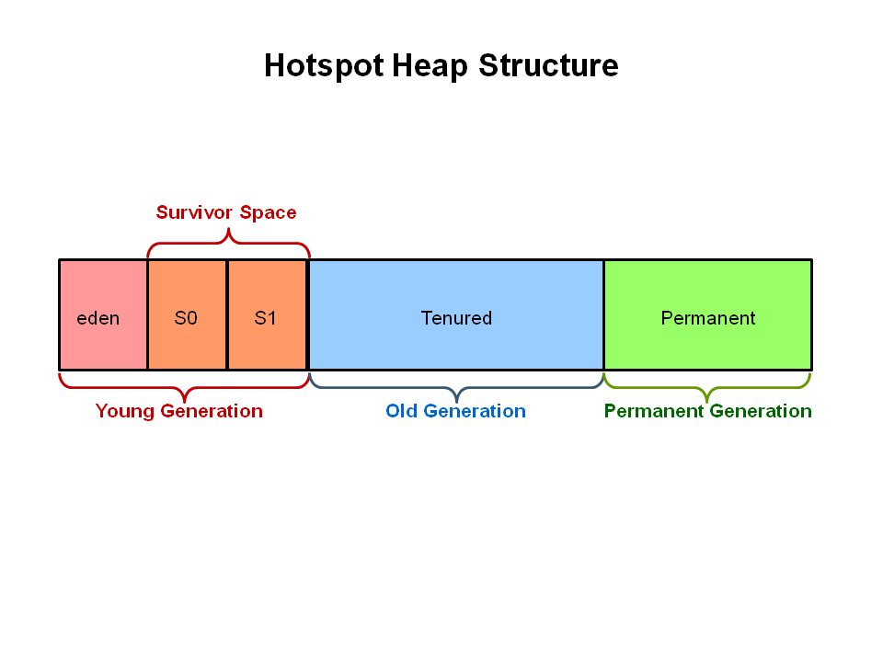
GC high-level overview
The Young Generation is where all new objects are allocated and aged. When the young generation fills up, this causes a minor garbage collection.
Stop the World Event - All minor garbage collections are "Stop the World" events. This means that all application threads are stopped until the operation completes. Minor garbage collections are always Stop the World events.
The Old Generation is used to store long surviving objects. Typically, a threshold is set for young generation object and when that age is met, the object gets moved to the old generation. Eventually the old generation needs to be collected. This event is called a major garbage collection.
(For internal use only) @danlucianrosu
Notes:
The Permanent generation contains metadata required by the JVM to describe the classes and methods used in the application. The permanent generation is populated by the JVM at runtime based on classes in use by the application. In addition, Java SE library classes and methods may be stored here.

Slide 13
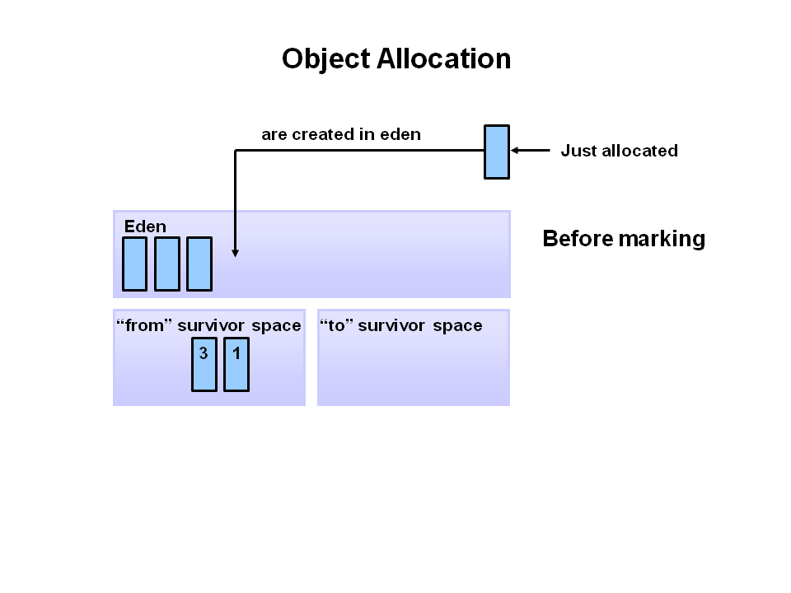
Phase 1
Any new objects are allocated to the eden space. Both survivor spaces start out empty.
(For internal use only) @danlucianrosu

Slide 14
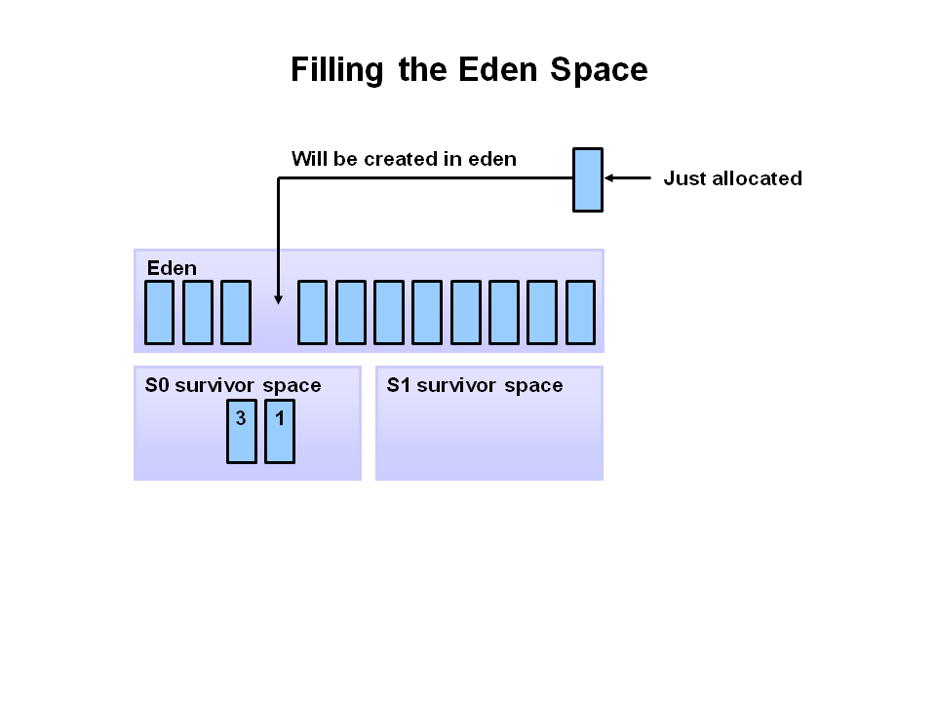
Phase 2
When the eden space fills up, a minor garbage collection is triggered.
(For internal use only) @danlucianrosu

Slide 15
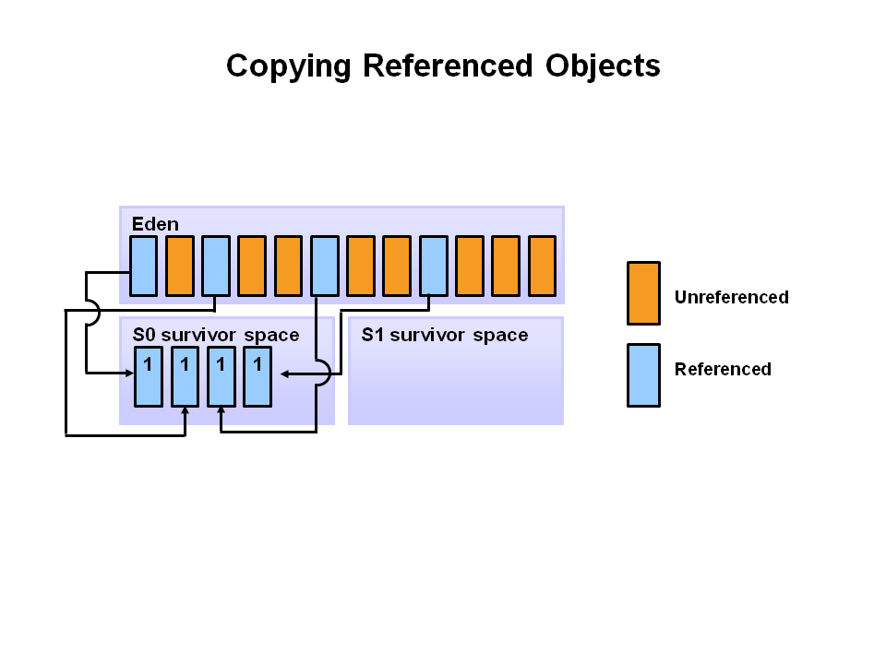
Phase 3
Referenced objects are moved to the first survivor space. Unreferenced objects are deleted when the eden space is cleared.
(For internal use only) @danlucianrosu

Slide 16
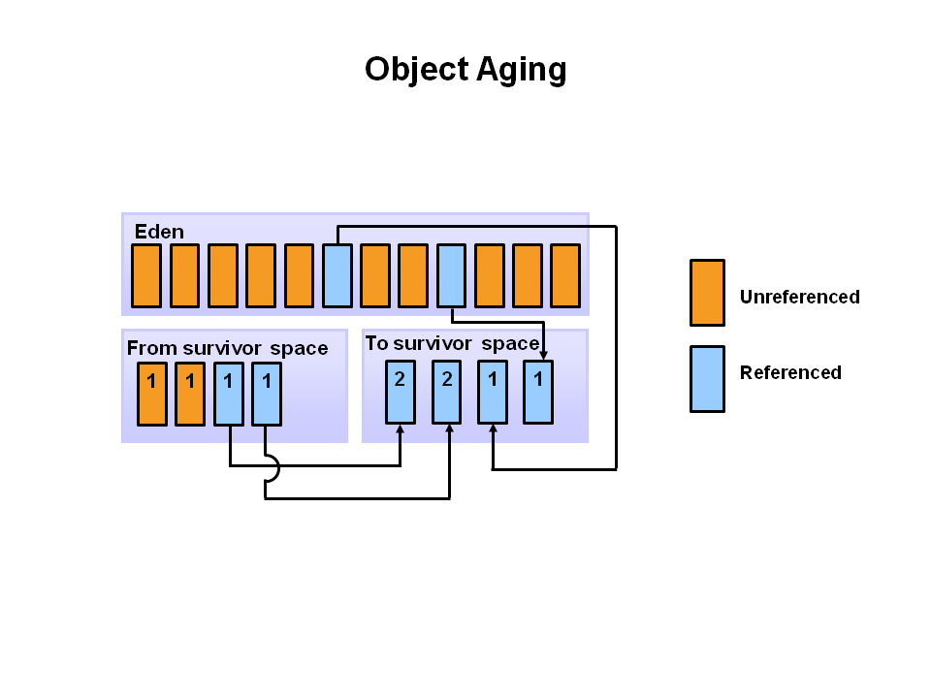
Phase 4
At the next minor GC, the same thing happens for the eden space. Unreferenced objects are deleted and referenced objects are moved to a survivor space. However, in this case, they are moved to the second survivor space (S1). In addition, objects from the last minor GC on the first survivor space (S0) have their age incremented and get moved to S1. Once all surviving objects have been moved to S1, both S0 and eden are cleared.
(For internal use only) @danlucianrosu
Notes:
Notice we now have differently aged object in the survivor space.

Slide 17
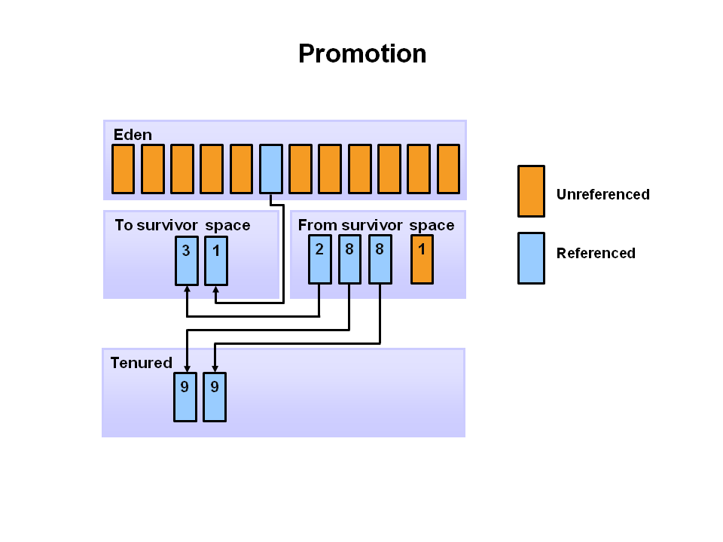
Phase 5
After a minor GC, when aged objects reach a certain age threshold (8 in this example) they are promoted from young generation to old generation.
(For internal use only) @danlucianrosu
Notes:
Notice we now have differently aged object in the survivor space.

Slide 18
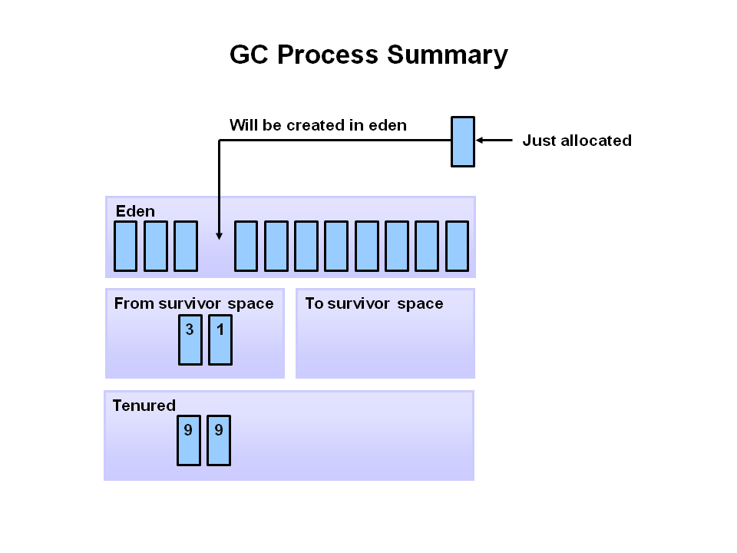
Phase 6
So that pretty much covers the entire process with the young generation. Eventually, a major GC will be performed on the old generation which cleans up and compacts that space.
(For internal use only) @danlucianrosu
Notes:
Notice we now have differently aged object in the survivor space.

Slide 19
Garbage Collectors available for Java
Flag | Description
-Xms | Initial heap size when the JVM starts
-Xmx | The maximum heap size
-Xmn | The size of the Young Generation.
-XX:PermSize | The starting size of the Permanent Generation.
-XX:MaxPermSize | The maximum size of the Permanent Generation
35
The Concurrent Mark Sweep
The Serial GC
The Parallel GC
The G1
SE 5,6
SE 5,6
SE 5,6
SE 7,8
Notes:
The serial collector is the default for client style machines in Java SE 5 and 6. With the serial collector, both minor and major garbage collections are done serially (using a single virtual CPU).
The parallel garbage collector uses multiple threads to perform the young generation garbage collection. By default on a host with N CPUs, the parallel garbage collector uses N garbage collector threads in the collection.
CMS collector on young generation uses the same algorithm as that of the parallel collector.
The G1 collector is a parallel, concurrent, and incrementally compacting low-pause garbage collector

Slide 20

Oh! Memory leaks?
Rly?
I thought Java solves this problem...

Slide 21
Memory leak DEF
A memory leak in Java is a situation where some objects are not used by the application any more, but GC fails to recognize them as unused. As a result, these objects remain in memory indefinitely, reducing the amount of memory available to the application.
(For internal use only) @danlucianrosu

Slide 22


Slide 23


